Slide 1

Nariksha Pads Pvt. Ltd
Nari ki Raksha
Developing Biodegradable sanitary
napkin by utilizing parali and biowaste

Slide 2


Problem Statement
Tackling the Parali waste problem
To solve the women mensuration problem

Slide 3







Solution
discarded
paddy straw
Parali
Towards zero cycle circular economy
Biodegradable
pads
Used biodegradable
napkin works
like fertilizers
Providing to women

Slide 4

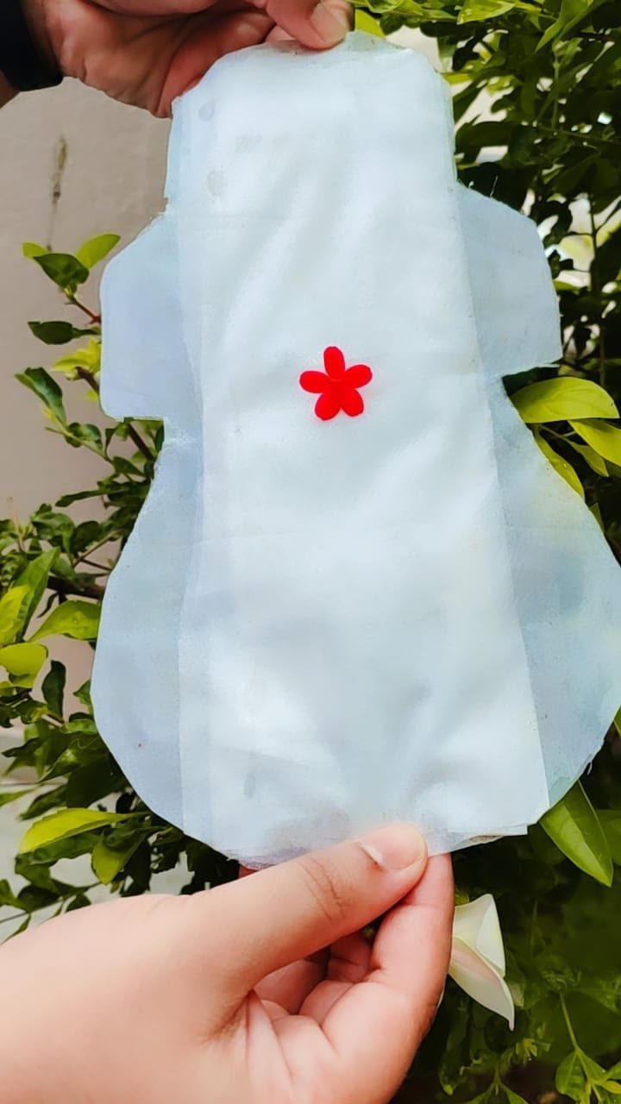
USP And Innovations

Slide 5
Current Status
Market Survey
validation
Feedback
Market survey with more than 100 women's
Verification at BITS laboratory
Analysis feedback of women
01
02
03
04
05
Prototype
MVP
Development of the prototype
MVP with 20
women's

Slide 6
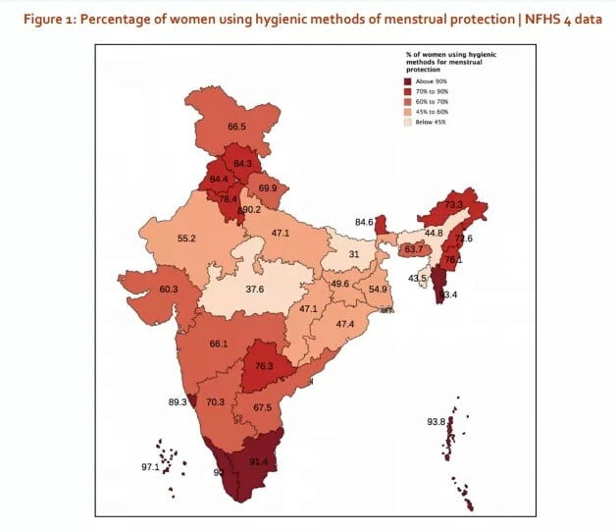
Customer/Market Analysis
Total Addressable Market for only India
US$ 550 Million
355 Million Total Menstruating women and girl in India
In India Among women in the age group (15-24 years), 48% use sanitary napkins, 36% use cloth, and 16% use locally prepared napkins
5-10% of the country’s Menstruating women
and girl using more hygiene sanitary pads
In India Organic feminine hygiene market is
forecasted to grow at a CAGR of 16.18% during the forecast period 2020 - 2025.
Initially Targeting environment conscious and
health-conscious girl regions that have ~ $27 Million market

Slide 7
Go To Market Strategy
Our go-to-market is focused on targeting NGO ,Organization working in the Women health hygiene segment with few cities initially in targeted locations and than gradually expanding to more locations.
Women health Organization
Organic Company
NGO
Product awareness in Measure Cities udaipur
10 Measure Cities
INDIA
SDG PROJECT

Slide 8
Competitive analysis
 | Direct competitor (organic or cloth) | Indirect competitors (Chemical based napkin) | NARIKSHA
Biodegradable | 80% | 0% | 100%
Herbal formulation | 10% | 10% | 100%
Organic SAP | 0% | 0% | 100%
Performance of Blood absorption | 75% | 90% | 100%
Recycle Material used | 60% | 0% | 100%
Cost/Price | INR 180 | INR 50 | INR 60

Slide 9




Unit Economics
Outsourcing Partner
Nariksha
Distributer
User
INR 2.5/pad
INR 4.8/pad
INR 7.2/pad
INR 10/pad
Our margin = INR 2.8/pad

Slide 10
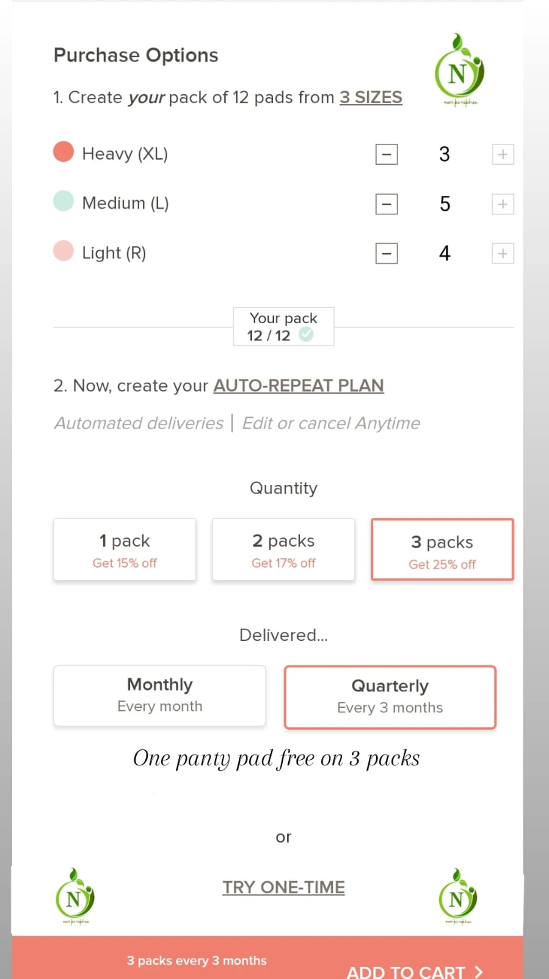
Website overview
Choose and Customize your own pad then order the perfect pad
2. Get discount with monthly subscription
3. Get the Gift of panty pads with 3 Months package

Slide 11




Revenue model
Sales (B2B)
Sales to Environment
Conscious women’s
Distributor
And
Retailer
Subscription model
The women can buy from website online platform and SDG platform.

Slide 12








Impact On Women's And Sustainable Goals
Biodegradable
Climate action
Employment to rural women's
Towards
Zero Waste
Circular
Economy
Clean water and sanitation
Good health and well being
Helping farmers
Recycle bio-waste

Slide 13



Management Team
Meghna Rathore
Founder, R&D and
Product development
MBA from MLSU (Udaipur)
Ravindra Singh
Business Development
Technical Development
BTECH from CTAE (Udaipur)
Dr. Vidhya Bhati
Research and marketing Development
Assistant Professor
Mayurakshi College Of Agriculture

Slide 14





Thank you.
meghnarathore024@gmail.com
9079798265
https://instagram.com/nariksha_?igshid=et4wv2edpy2i
https://www.facebook.com/Nariksha-101532351928722/
https://www.linkedin.com/company/nariksha-pads-private-limited

